Slide 1
Programming
Merit Badge PowerPoint
© 2018 - 2020 Robert Baker

Slide 2
Merit Badge Counselor
Darrell Pelan
xyz@gmail.com
937-xxx-xxxx
REMEMBER Two Deep Communication RULES
ALWAYS copy someone else when sending anything to me (Parent, Scoutmaster, etc)

Slide 3
Merit Badge Requirements
Cyber Chip
Complete the workbook
Complete three programs by the third weekend
Let’s talk about your capability
C
Excel
Arduino
Web
Sample programs at www.boyslife.org/programming

Slide 4
Programming Requirements
5A
Choose either sample program in C or Visual Basic
Change the program to convert Celsius to Fahrenheit
5B
Change the other sample program to convert Celsius to Fahrenheit
5C
Retail Store using language of your choice. Must be approved in advance.
Details will be discussed during week 2

Slide 5
What is Programming?
Programming is the act of inserting instructions into a computer or machine to be followed.
There are many different career fields involving the programming of computers; each utilizing different languages, techniques, and systems.
We are only going to cover a few of the different aspects of programming during this Merit Badge, but there are so many more.
“A computer is a stupid machine with the ability to do incredibly smart things, while computer programmers are smart people with the ability to do incredibly stupid things.” – Bill Bryson

Slide 6
Safety
Normally programming normally involves computers, which use electricity. It is important to make sure all power-cords are not frayed, and to keep liquids far away to prevent electric shock.
RSI – Repetitive Stress Injury
Caused by typing for long periods of time and can cause pain in the wrists and hands
How can RSI be prevented?
Notes:
RSI Prevention
Proper keyboard height & position
Ergonomic keyboards
Quality chairs

Slide 7
Safety
Eye Strain can be caused by using computer screens for extended periods of time.
How can eye strain be prevented?
Notes:
Eye Strain Prevention
Proper monitor height
Blue blocking glasses
20/20/20 Rule

Slide 8

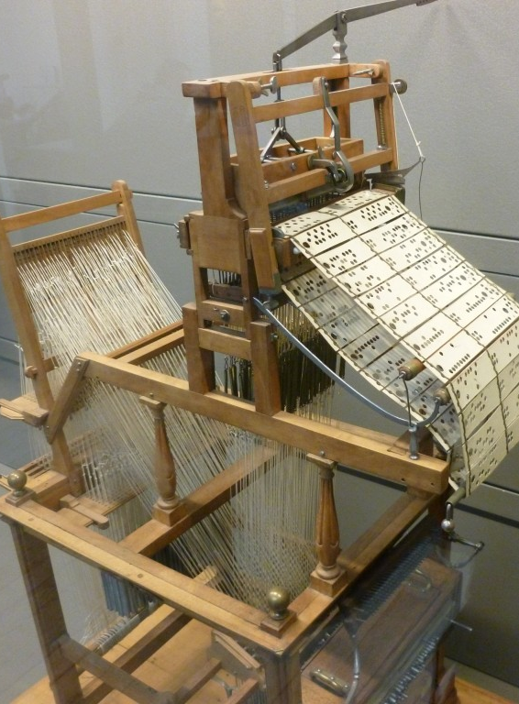
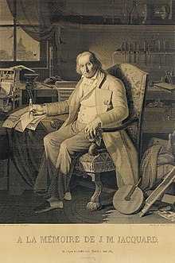
History - Before Computers
Before the modern electrical computer, mechanical devices used in factories were the first machines to be programmed.
An example is the Joseph Jacquard Loom (1804) which used hole-punched cards to “program” patterns into fabric.
The picture on the left is the loom.
The picture on the right is a portrait of Jacquard was woven in silk on a Jacquard loom and required 24,000 punched cards to create (1839). One of these portraits in the possession of Charles Babbage inspired him in using perforated cards in his Difference Engine.

Slide 9
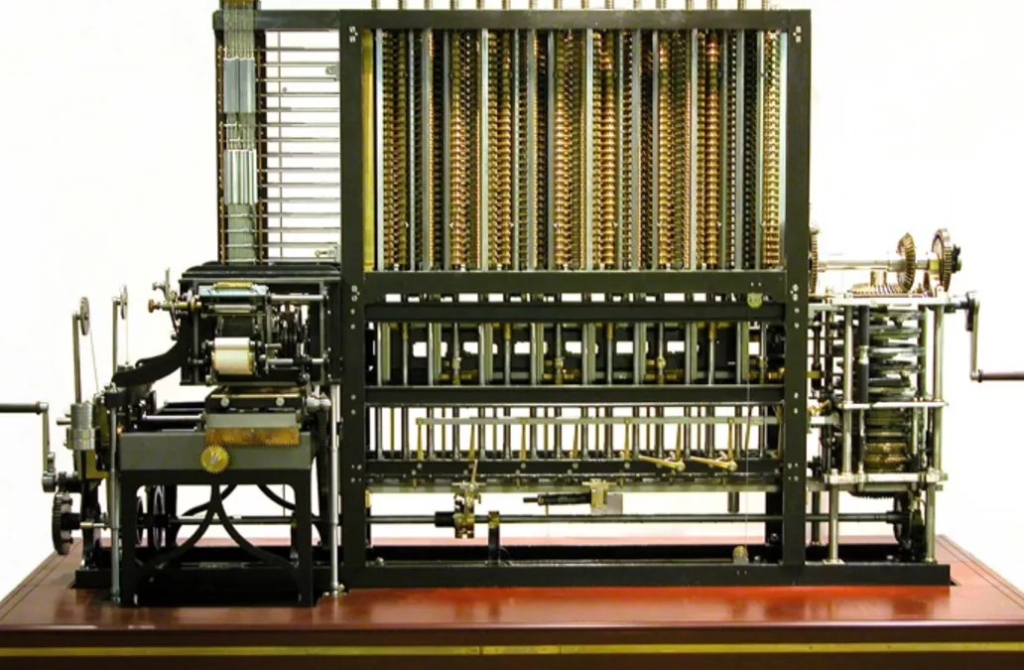
Before Computers
Charles Babbage in 1823 started work on his Difference Engine. It was programmed using punch cards and could do simple calculations to 31 digits. Due to high costs, it was not built until 1991, well after his death in 1899. It weighed 15 tons and was 8 ft tall.
It used human-power to turn the gears and cranks and output the result using wheels with digits painted on.
Fun Fact: The gear technology didn’t exist to build his machine, so Babbage invented new ways of cutting gears. This incidentally advanced machinery and factories during the end industrial revolution (1760-1840).
Ada Lovelace, the first programmer, theorized how to program Babbage's Machines.

Slide 10
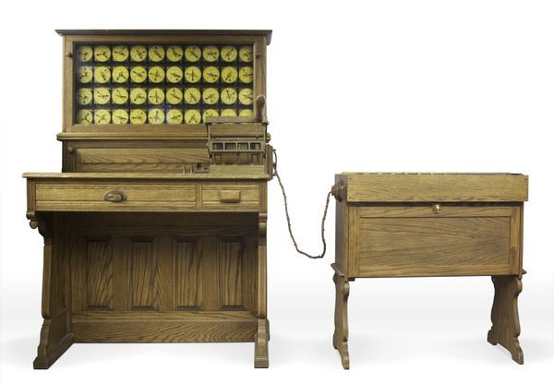
Before Computers
In 1885, Herman Hollerith designed the “Electric Tabulating System”, a machine designed to take on the 1890’s Census. It was an early Scantron-like machine using punch cards.
The 1880’s Census took 7 years to count, so due to the growing population, the 1890’s and 1900’s Censuses would have taken more than 10 years. This would not be good.
With his machine, the 1890’s Census only took 6 weeks rather than 10 years. This proved computers were a viable solution to many previously impossible problems.

Slide 11
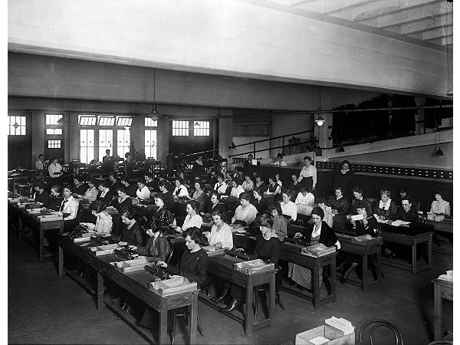
First Computers
A “Computer” used to be a job description, not an electronic machine
Women almost exclusively filled these positions.
Large agencies would have “Computer Rooms” with many ladies doing calculations by hand
Check out the movie “Hidden Figures”
A “kilogirl” was a unit of measurement equaling 1000 hours of computing labor

Slide 12
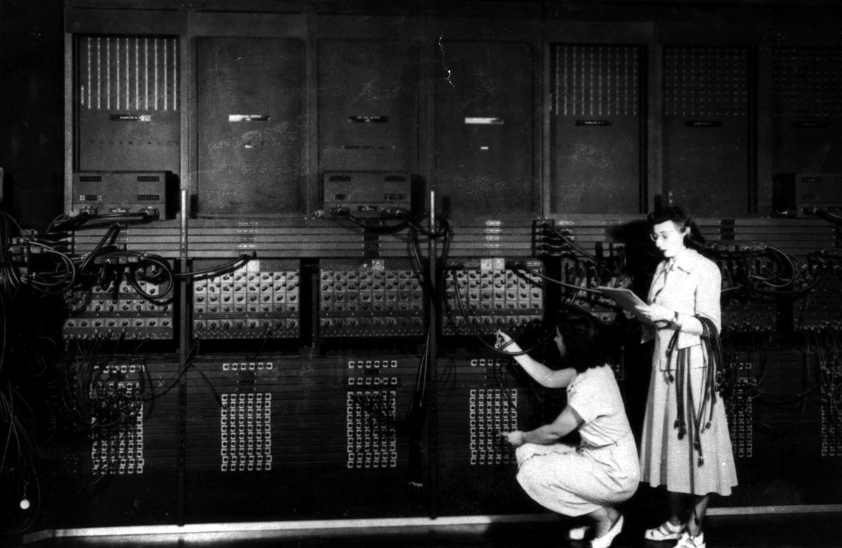
Early Computers (Vacuum Tubes)
ENIAC – Electronic Numerical Integrator And Computer (1946)
First general-purpose computer
Used Base-10 instead of Binary (Base-2)
They used Vacuum Tubes and Mechanical Switches
Used to calculate firing-tables for the military.
UNIVAC – UNIVersal Automatic Computer (1951)
First commercial computer
Brought computers into the public eye after it correctly predicted the “total-upset, landslide”, 1952 Presidential Election.
ENIAC 1946 – What do you notice about this photo
Notes:
Women, not men, were the ones running these early computers.
This led to many women leading computer science into the 21st century, i.e. Grace Hopper, who programed the ENIAC. She also designed COBOL. This language is still used today.

Slide 13
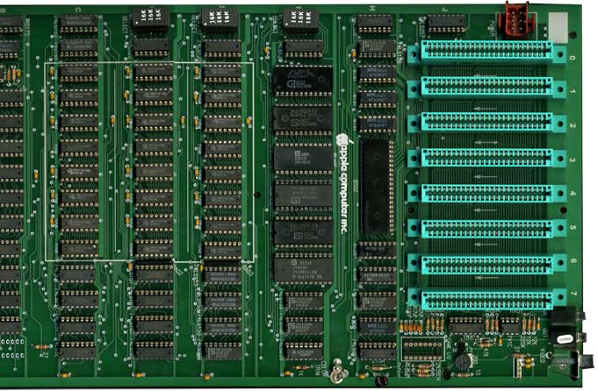
Pre-Modern Computers (Integrated Circuits)
After Vacuum Tube and Mechanical Switched computers, Integrated Circuits (ICs) allowed computers to get much smaller. Computers when from the Size of buildings to the size of desks.
This also allowed more powerful computers to be built because less space was needed.
This is an Apple2 motherboard.
All the black chips make the CPU.
Each one is about 1” wide.

Slide 14
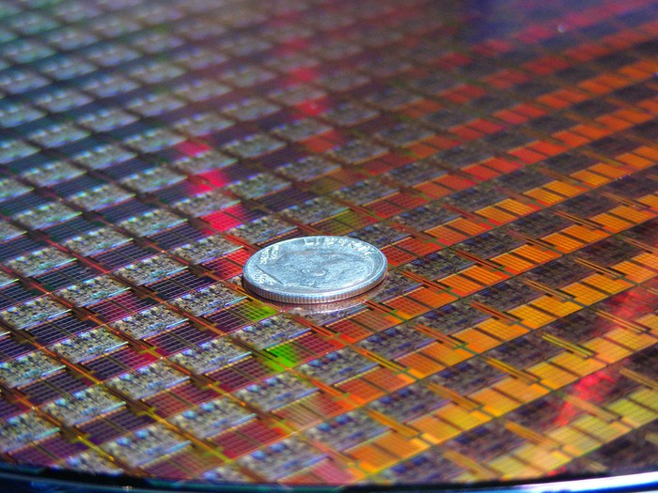
Modern Computers
The Microprocessor allowed computer central processing units (CPU) to go from the size of desks to the size of a dime!
Each small square in this picture is a CPU!
This allowed engineers to make computers even more powerful and support more powerful language features.
Each “switch” in these chips are 10nm wide

Slide 15
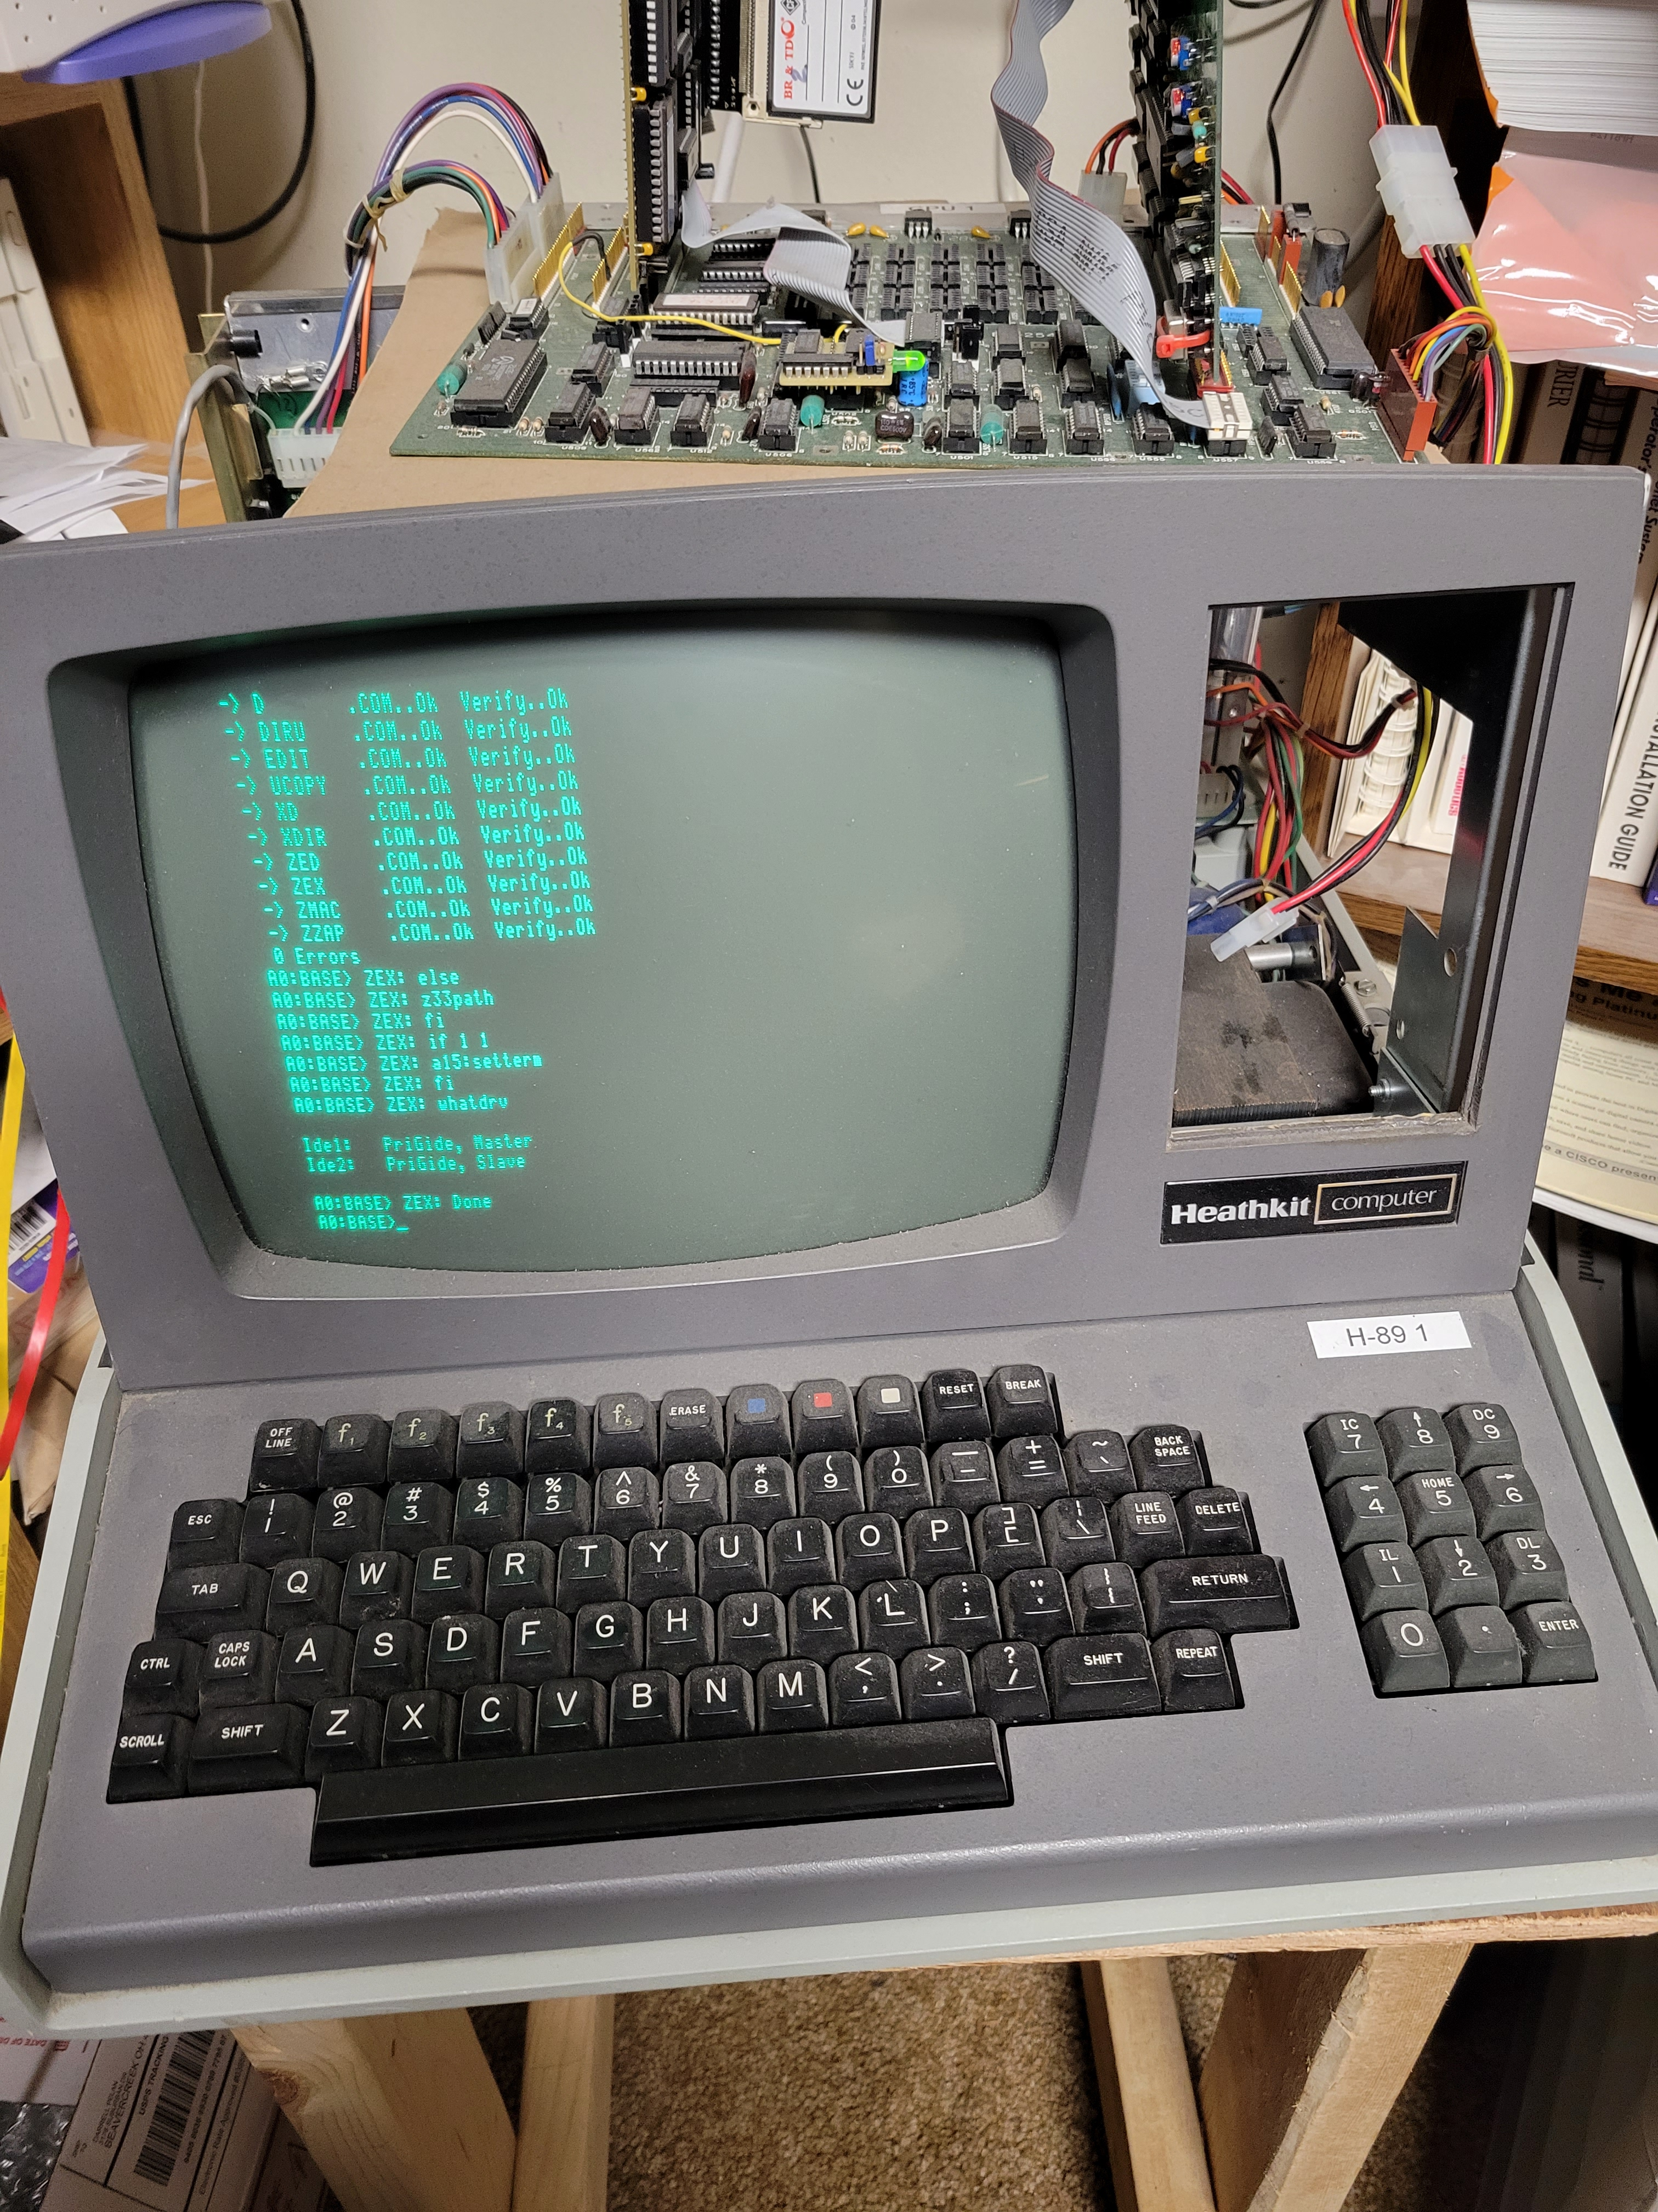
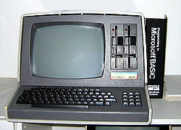
My First Computer Purchased in 1982

Slide 16
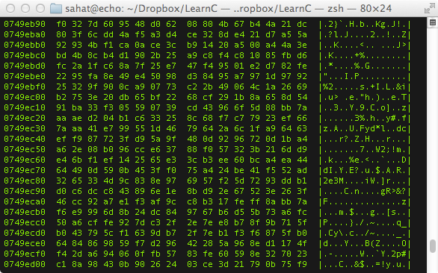
History of Programming
What was the first programming language?
Binary / Machine Language (ML)
Binary / ML is really hard to read, but it can be done.
Early computers used switches and cables to accomplish this.
It is insanely fast, only limited by hardware speed.
All programming languages end up as Binary / ML at some point during execution.
Notes:
Notice that is Binary / ML is actually represented in Hex, which is just a more compact way for writing Binary.
The column of 8 numbers on the left is the hardware memory address in RAM where each line of code is stored.
The next two big columns are the actual code separated into bytes (each 2 characters is 1 byte).
The third column is the ASCII representation of the data in the previous two big columns.

Slide 17
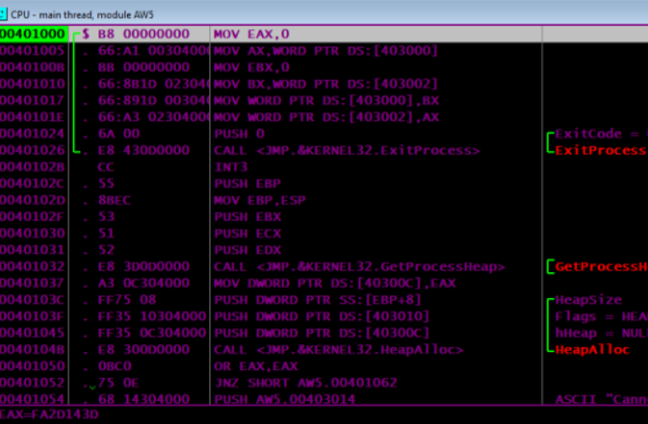
History of Programming
Next came Assembly Language (ASM)
Slightly easier to read than Binary / ML
Still very fast because it maps back to Binary / ML
Very few people ‘need’ to program is ASM
There is a different Assembly Language for each CPU design, so it is not portable code.
Why is portable code good?
Notes:
This is a program I wrote for my Assembly class.
In this photo you can see the hardware memory address in the left-most column.
In the widest column is a x86-Assembly code (MOV EAX,0)
The second column from the left is the Machine Language generated from the x86-Assembly code.

Slide 18
History of Programming
Next-Generation Languages came around the 1950’s.
They allowed:
Code portability between different systems
Easier to write, read and debug code
Allowed for new concepts (i.e. functions, classes, objects, OOP)
Explored new fields (i.e. science, math, computer science, data science, business)
The first big languages were… (in order of creation)
FORTRAN, LISP, COBOL, BASIC and Pascal
Notes:
A lot of old code that was written in FORTRAN or COBOL is still in use today because it would be too expensive to rewrite it.
Also there are huge sections of code that is “dead-code”. People don’t know what it does, so they don’t touch it and it just sits there.

Slide 19
General Knowledge

Slide 20
Programming Now
How many languages do you recognize?
C
C++
Java
JavaScript
HTML
CSS
Python
Ruby
PHP
OpenCL
SQL
MATLAB
Erlang
Ada
Objective-C
Swift
Mathematica
C#
Visual Basic
Rust
F#
R
Go
PowerShell
BASH
TypeScript
PostScript
CoffeeScript
Perl
x86-Assembly MASM
RegEx
PL/SQL
MIPS
ColdFusion
LaTeX
XML
JSON
Ladder Logic
YAML
Batch

Slide 21
Requirement 5a
Pick one of the two example programs and change it to convert from Celsius to Fahrenheit
C using Visual Studio
Visual Basic using Excel

Slide 22
Program 1 in C (compile using Visual Studio)
// Example F to C program in "c"
#include <iostream> // Tells your code what functions such as printf() mean.
const float LOW_TEMP_F_WARNING = 30.; // Program constants
const float HIGH_TEMP_F_WARNING = 95.;
const int MAX_LOOP = 5.;
int main() // Declaration of program
{
float temp_f = 0, temp_c = 0;// declaration of variables that the program will use
int i;
for (i = 0; i < MAX_LOOP; i++) { // loop
printf_s("\nEnter the temperature in degrees F : ");
scanf_s("%f", &temp_f); // Reads the user input
temp_c = (temp_f - 32.) / 1.8; // Math formula to convert Fahrenheit to Celsius
printf_s("The temperature in Celsius (C) is %5.2f\n", temp_c); // Output the Celsius result
if (temp_f > HIGH_TEMP_F_WARNING) { // Check for high temperature
printf_s("Remember to hydrate\n");
}
if (temp_f < LOW_TEMP_F_WARNING) { // Check for low temperature
printf_s("Remember to pack Long underwear\n");
}
}
return(0); // exits the program
}

Slide 23
Program 1 – Visual Basic using Excel
Add to WorkSheet in Visual Basic
Private Sub Worksheet_Change(ByVal Target As Range)
Dim KeyCells As Range
' The variable KeyCells contains the cells that will
' cause an alert when they are changed.
Set KeyCells = Range("B4:B4")
If Not Application.Intersect(KeyCells, Range(Target.Address)) Is Nothing Then
' Display a message when one of the designated cells has been
' changed.
' Place your code here.
SetTemp
End If
End Sub

Slide 24
Program 1 – Visual Basic using Excel
Add to Module in Visual Basic
' Program setTemp()converts the temperature in cell B4 from Farenheight to Celsuis.. The result is stored in cell B6.
' if the temperature is higher or lower than warning values in cells B8 or B10, a warning is displayed.
' Author: Darrell Pelan
' 12 Jan 2022
'
Sub SetTemp()
'temperature variables
Dim tempf As Variant
Dim tempc As Variant
tempf = 0
tempc = tempf
tempf = Cells(4, 2)
tempc = (tempf - 32) / 1.8
Cells(6, 2) = tempc
If tempf > Cells(8, 2) Then
MsgBox "Make Sure to Hydrate!!", vbOKOnly, "HIGH Temperature Warning"
End If
If tempf < Cells(10, 2) Then
MsgBox "Remember to pack Long underwear", vbOKOnly, "LOW Temperature Warning"
End If
End Sub

Slide 25
End Day 1

Slide 26
Programming Now
Why are the languages grouped into colors?
C
C++
Java
JavaScript
HTML
CSS
Python
Ruby
PHP
OpenCL
SQL
MATLAB
Erlang
Ada
Objective-C
Swift
Mathematica
C#
Visual Basic
Rust
F#
R
Go
PowerShell
BASH
TypeScript
PostScript
CoffeeScript
Perl
x86-Assembly MASM
RegEx
PL/SQL
MIPS
ColdFusion
LaTeX
XML
JSON
Ladder Logic
YAML
Batch

Slide 27
C
C++
Java
JavaScript
HTML
CSS
Python
Ruby
PHP
OpenCL
SQL
MATLAB
Erlang
Ada
Objective-C
Swift
Mathematica
C#
Visual Basic
Rust
F#
R
Go
PowerShell
BASH
TypeScript
PostScript
CoffeeScript
Perl
x86-Assembly MASM
RegEx
PL/SQL
MIPS
ColdFusion
LaTeX
XML
JSON
Ladder Logic
YAML
Batch

Slide 28
C
C++
Java
JavaScript
HTML
CSS
Python
Ruby
PHP
OpenCL
SQL
MATLAB
Erlang
Ada
Objective-C
Swift
Mathematica
C#
Visual Basic
Rust
F#
R
Go
PowerShell
BASH
TypeScript
PostScript
CoffeeScript
Perl
x86-Assembly MASM
RegEx
PL/SQL
MIPS
ColdFusion
LaTeX
XML
JSON
Ladder Logic
YAML
Batch
The Green Languages are General Programing Languages
The Purple Languages are Scripting Languages
The Red Languages are Markup Languages
The Blue Languages are Declarative Languages
The Orange Languages are Assembly Languages
Different types of languages have different purposes.
It is important to match the type of work to the correct language to insure the best results.

Slide 29
Programming Languages
Here are a few languages and the problems they try to tackle…
C++ – General Purpose, High Performance | ex. Game Engines, Desktop Apps (Adobe Photoshop, Chrome)
C – General Purpose, High Performance, Light Weight | ex. Linux OS, macOS, Integrated Circuits, Drivers
Java – General Purpose, Multiplatform | ex. Minecraft, Server Apps, Android Apps
C# – General Purpose, Windows Platform | ex. Unity Games, Server Apps, StackOverflow
Swift – General Purpose, iOS & macOS | ex. most apps for iPhones and macOS (replaced Objective-C)
SQL – Database Communication
JavaScript – General Web Scripting | ex. Interactive webpages, webpages that can run dynamic code
HTML – Webpage Design, Layout and Markup
CSS – Webpage Styling, Coloring, Fonts and Positioning
PHP – Web Server Code | ex. Backend Web Dev., Web Content Management Systems (i.e. WordPress)
TypeScript – Stricter Superset of JS that transpiles into JS |ex. Large JavaScript Apps
XML – Human and Machine readable file format for data sharing between apps

Slide 30
Programming Examples
Hello World
C++
#include <iostream> int main(int argc, char *argv[])
{
char myString[] = “Hello World!”;
std::cout << myString << std::endl;
return 0;
}
Java
class HelloWorld {
private String myString = "Hello World!";
public static void main(String args[]) {
System.out.println(myString);
}
}
Notice how different languages can look very different even when they are doing the same task.
Notice also how the bracing ( i.e. “{}”) style is different between languages.
Notes:
The reason for the different colors here is due to syntax highlighting.
Syntax Highlighting is a feature in programming apps where it automatically colors different parts of the code to increase readability.

Slide 31
Programming Examples
Hello World
C#
using System;
using System.Collections.Generic;
using System.Text;
namespace ConsoleApplication1
{
class HelloWorld
{
String myString = "Hello, world!";
static void Main(string[] args)
{
Console.WriteLine(myString);
}
}
}
X86 Assembly
.486
.model flat, stdcall
.stack 100h
option casemap :none
ExitProcess PROTO Near32 stdcall, dwExitCode:dword
putch PROTO Near32 stdcall, bChar:byte; .data
strMyString byte "Hello World",0
.code
main PROC
mov ecx, LENGTHOF strMyString
mov esi, OFFSET strMyString
L1:
invoke putch, byte PTR esi
inc esi
loop L1
invoke ExitProcess,0
main ENDP
END main
Notes:
The reason for the different colors here is due to syntax highlighting.
Syntax Highlighting is a feature in programming apps where it automatically colors different parts of the code to increase readability.

Slide 32
Programming Examples
Hello World
JavaScript
myString = "Hello World!";
console.log(myString);
Python
myString = 'Hello World!'
print(myString)
Notice how different languages can look very different even when they are doing the same task.
Notes:
The reason for the different colors here is due to syntax highlighting.
Syntax Highlighting is a feature in programming apps where it automatically colors different parts of the code to increase readability.

Slide 33
Programming Language Types
Languages can be split into a three different levels..
High-Level (ex. Python, Ruby, JavaScript, Java, SQL)
C-Level (ex. C, C++, Rust)
Low-Level (x86 Assembly, Machine Language)

Slide 34
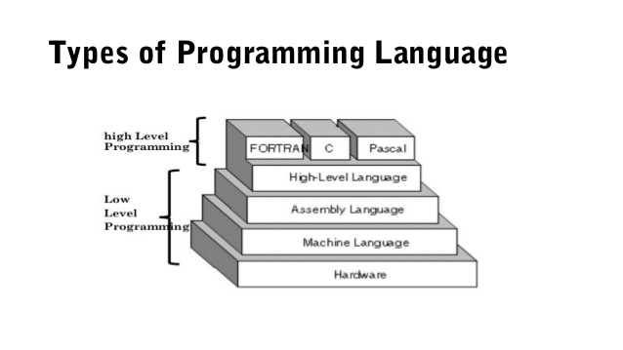
Programming Language Types
Why would you use a High-Level, Low-Level or C-Level language?
Low Level
Pros: Fast Execution, No Overhead, Single Platform, Compiled
Cons: Hard to read, write, debug, and maintain
Examples: ML, MASM, TASM, NASM, MIPS
High-Level
Pros: Easier to read, write, debug, and maintain, Multi-Platform, Compiled or Interpreted
Cons: Slower than Low-Level, not as much control over hardware
Examples: Python, Ladder-Logic, JavaScript, Java, SQL
C-Level
Best of both worlds, Compiled
Good control over hardware with ease of writing.
Examples: C, C++, Rust, FORTRAN, PASCAL
Note: Java, Python, etc. are one level higher than FORTAN, C and PASCAL

Slide 35
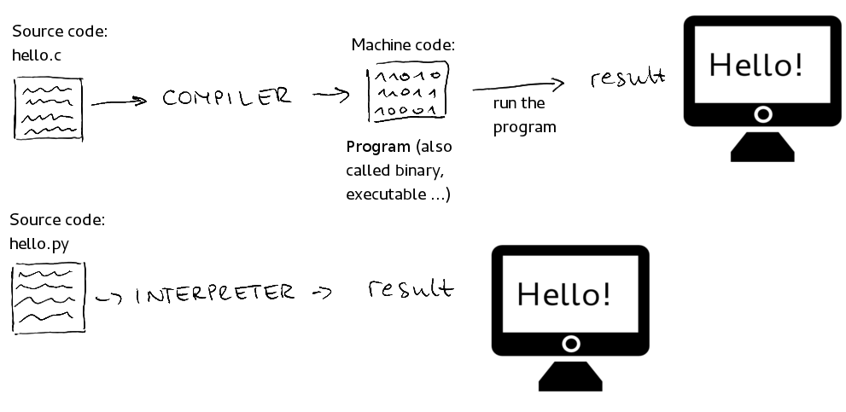
Programming Language Types
This photo illiterates the difference between compiled and interpreted languages…
Use your computers to make a list of 3 compiled languages and 3 interpreted languages.
Where would you use a compiled languages vs an interpreted language?
Done every time
Done once
Done every time

Slide 36
Programmed Devices
Our lives are filled with so many programmed devices, you may not even notice…
What are some things around your house that are programmed?
Smart TVs, Smart Door Bells
Xbox, PlayStation, Wii, Ms. Pacman
Microwave, Wi-Fi Router (these two are the same thing)
Etc..
What language do you think these were programmed in?

Slide 37
Requirement 5c
Simple Retail Store
Create array for five items (Item number, Price, Discount) inventory[5][3]
Create array for up to five order lines (inventory position, number of products) order[5][2]
Use two functions
getItemID – gets the item and number bought
calculateTotalPrice – calculates and prints receipt
Ask User to enter an item number and the number of items purchased
Print Count, Item number, Price, Discount Price, Total Cost
Print Total price before Discount, Total Price after Discount, Savings, Subtotal, Sales Tax (6.75%), Total
Ask user if they would like to purchase another item

Slide 38
Pseudocode Requirement 5C
Write out pseudocode to plan your project
Load product data
Ask user for product and quantity
Ask user if done
Calculate prices for products ordered
Calculate total
Print Receipt
Ask user if they want to purchase something else

Slide 39
Programming Tips
Google is your best friend
Use an IDE that has error checking as you go
Use the IDE debugger
Udemy.com for online courses. Often on sale for $10.99
Github for code examples
Online Compiler https://www.onlinegdb.com/
C, C++, Python, PHP, Ruby, C#, VB, Perl, Swift, Prolog, Javascript, Pascal, HTML, CSS, JS

Slide 40
End Day 2

Slide 41
Intellectual Property (IP)
What are the four types of IP?
Copyright
Patent
Trademark
Trade Secret
Open your computers and go online.
Get the definitions of all four of these types of IP.

Slide 42
Intellectual Property (IP)
What is …
Copyright – protects a particular expression of an idea that the author created (i.e. PowerPoints, Game Art, Specific Code)
Patent – protects useful innovative processes or methods, machines, manufactured items, or “compositions of matter” (i.e. a new and revolutionary math algorithm used in an app)
Trademark – protects a word, phrase, symbol or sound that identifies and distinguishes the source of a particular product or service (i.e. Windows Logo, “Your mattress is freeee”, etc.)
Trade Secret – protects valuable information be not disclosing it to anyone, enforced by a contract called a NDA (i.e. what info Facebook collects)

Slide 43
Owning vs Licensing
Do I own a copy of PowerPoint?
Do I own a copy of Google Chrome?
Do I own a copy of an App I built?
What is the difference between owning and licensing?
Owning means you can do what ever you want to the software. Most people do not own software.
Licensing is where you “buy or get permission” to use the software, often subscription based.

Slide 44
License Types Explained
Use your computers to research the following key terms…
Open-Source
Closed-Source
Freeware
Shareware
Demo
Public Domain

Slide 45
License Types Explained
Use your computers to research the following key terms…
Open-Source – the code is exposed to the public and can be modified or distributed, may be limits or restrictions (doesn’t mean free).
Closed-Source – the code is NOT exposed to the public and cannot be edited or distributed (doesn’t mean free).
Freeware – 100% free to use, not necessarily free to be modified or distributed.
Shareware – free to download and use, but asked for donations (i.e. Ad-Block). Not free to modify or distribute.
Demo – A free trial version of the program, may not have all the features enabled. Not free to modify or distribute.
Pubic Domain – There is absolutely no ownership such as copyright, trademark, or patent. Software in the public domain can be modified, distributed, or sold even without any attribution by anyone.

Slide 46
Careers in Programming
What are some careers you have heard of in a programming field?
Computer Scientist
Mobile App Developer (dev)
Desktop App Dev
UI / UX Engineer
Software Engineer
Game Engine Dev
Gameplay Dev
Database Engineer
Hardware Engineer
Computer Engineer
Sysadmin
Hacker / Pen-Tester
Web Dev (frontend and backend)
Project Manager

